Slide 1

Decoding the market: A comprehensive analysis of soccer player evaluation
November 29, 2023
Professor: Lorena Martin
Shantanu Trivikram, Hayk Mkhitaryan, Jorge Garzon,
Aditya Dhanotia

Slide 2
Table of Contents
1Min
1-2min
2-3min
3-4 min
2-3min
1min
Study Objective
Data Description
Analysis
Results
Key Findings
Limitations/Recommendations

Slide 3
Study importance
Strategic Decision Making for Clubs:
Player Development Focus:
Financial Optimization:
Primary Hypothesis:
This hypothesis posits that factors - age, goals, assists, nationality, and position collectively or individually exert a measurable influence on how players are valued in the transfer market.

Slide 4
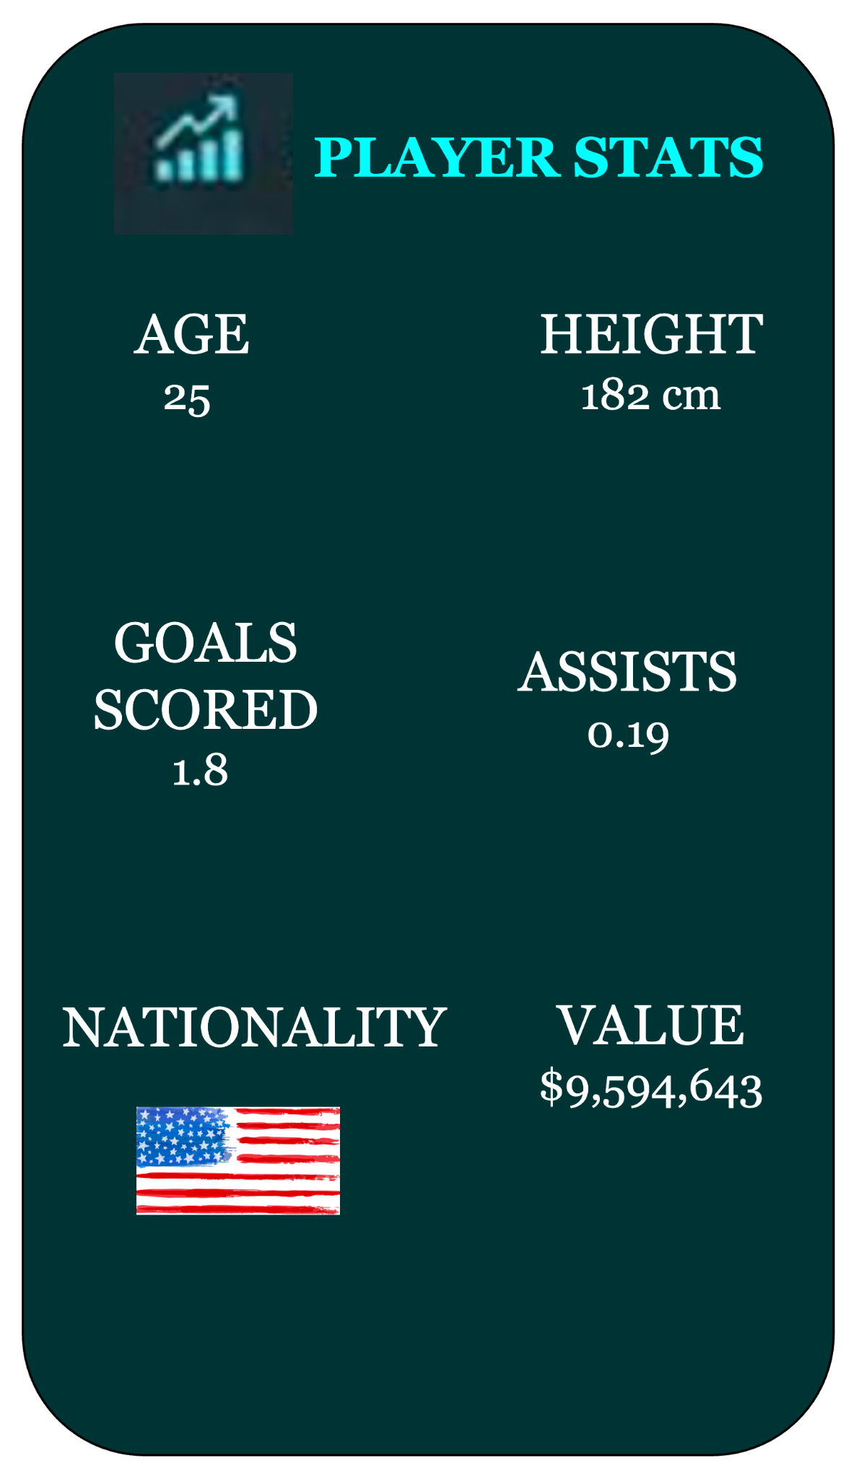
About the Data
Comprehensive soccer player dataset from Kaggle:
2300 entries, each representing an individual player
44 columns (variables on player for our study)
KPI’s:
Predictors (X) :
Goals Scored
Assists
Passes
Game minutes
Player’s position
Nationality
Response (Y) :
Value

Slide 5
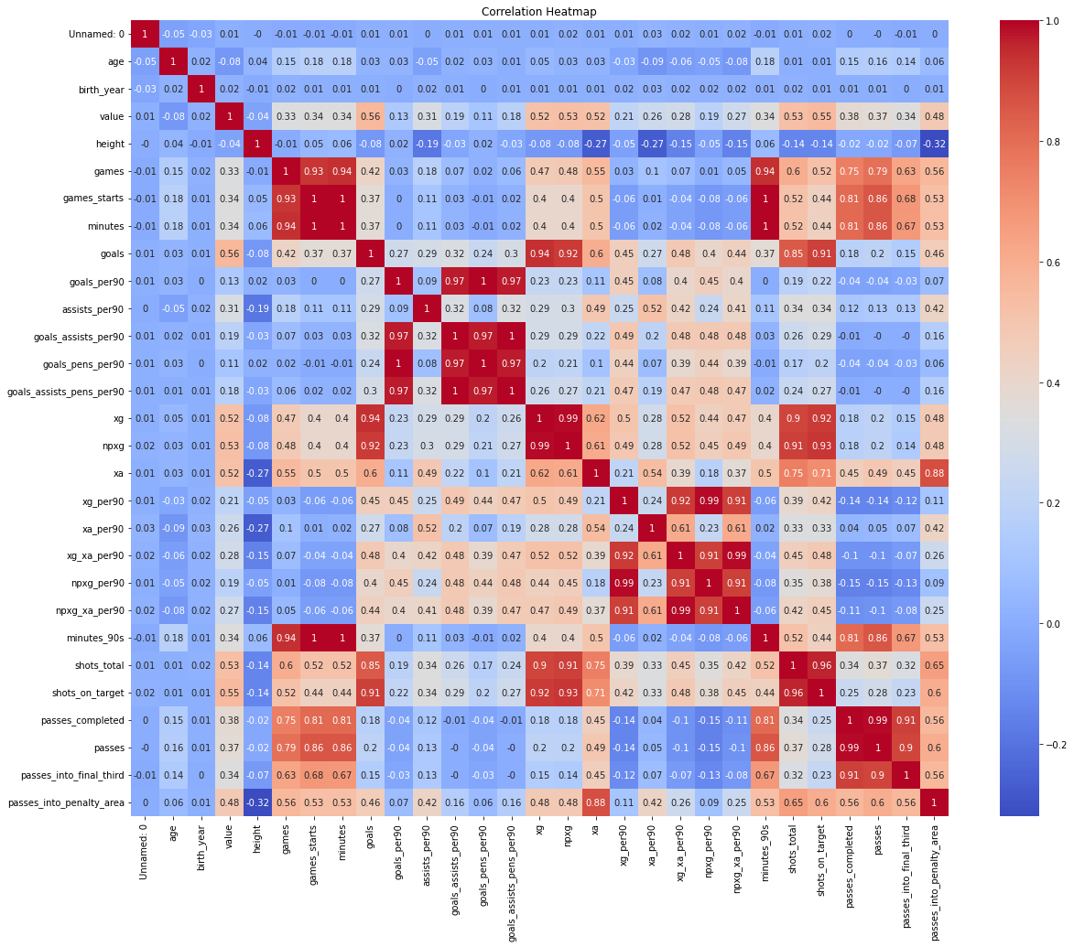
statistical analysis
Correlation
Nationality and player value correlation to identify nations with higher transfer values
Goals, assist, passes to transfer value
OLS Regression
Identify variables with significant p-values and R^2 that impact player’s transfer value based on player’s position
One-way ANOVA & Tukey’s HSD
Compare means of transfer values for different leagues. Identify which league means have significantly different transfer values from each other
Notes:
Identify which leagues have higher transfer value compared to others.

Slide 6
Results
Performance
Apart from goals, Expected goals(xG) and Assists(xA) turned out to be crucial variables
Positional and Nationality Difference
Attackers
Goals and xG with R2 of 65%
Defenders
Minutes played and Passes with R2 of 40%
Midfielders
Passes into Penalty area and xA with R2 of 51%
Goalkeepers
Save percentage and minutes played with R2 of 39%

Slide 7
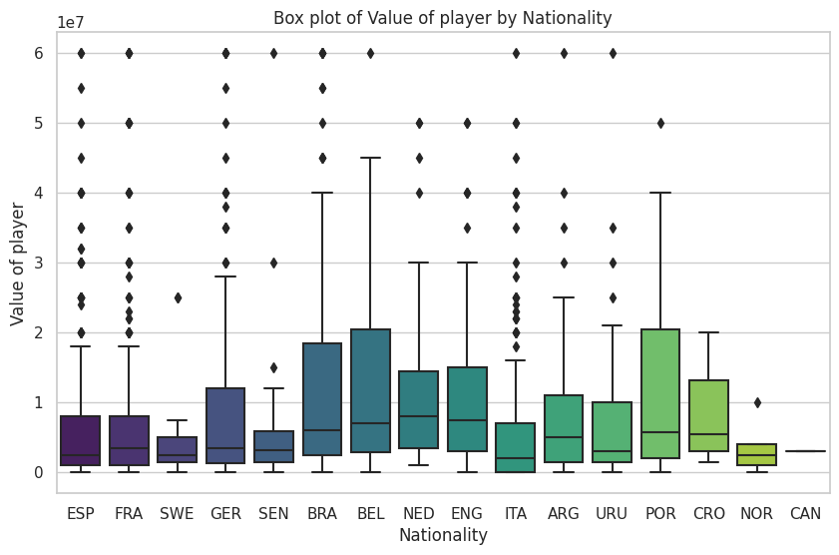
Results
3. Nationality
Attackers: Brazil, Portugal, Belgium
Defenders: Portugal, Netherlands, Brazil
Midfielders: England, Belgium
Goalkeepers: England, Germany, Brazil

Slide 8
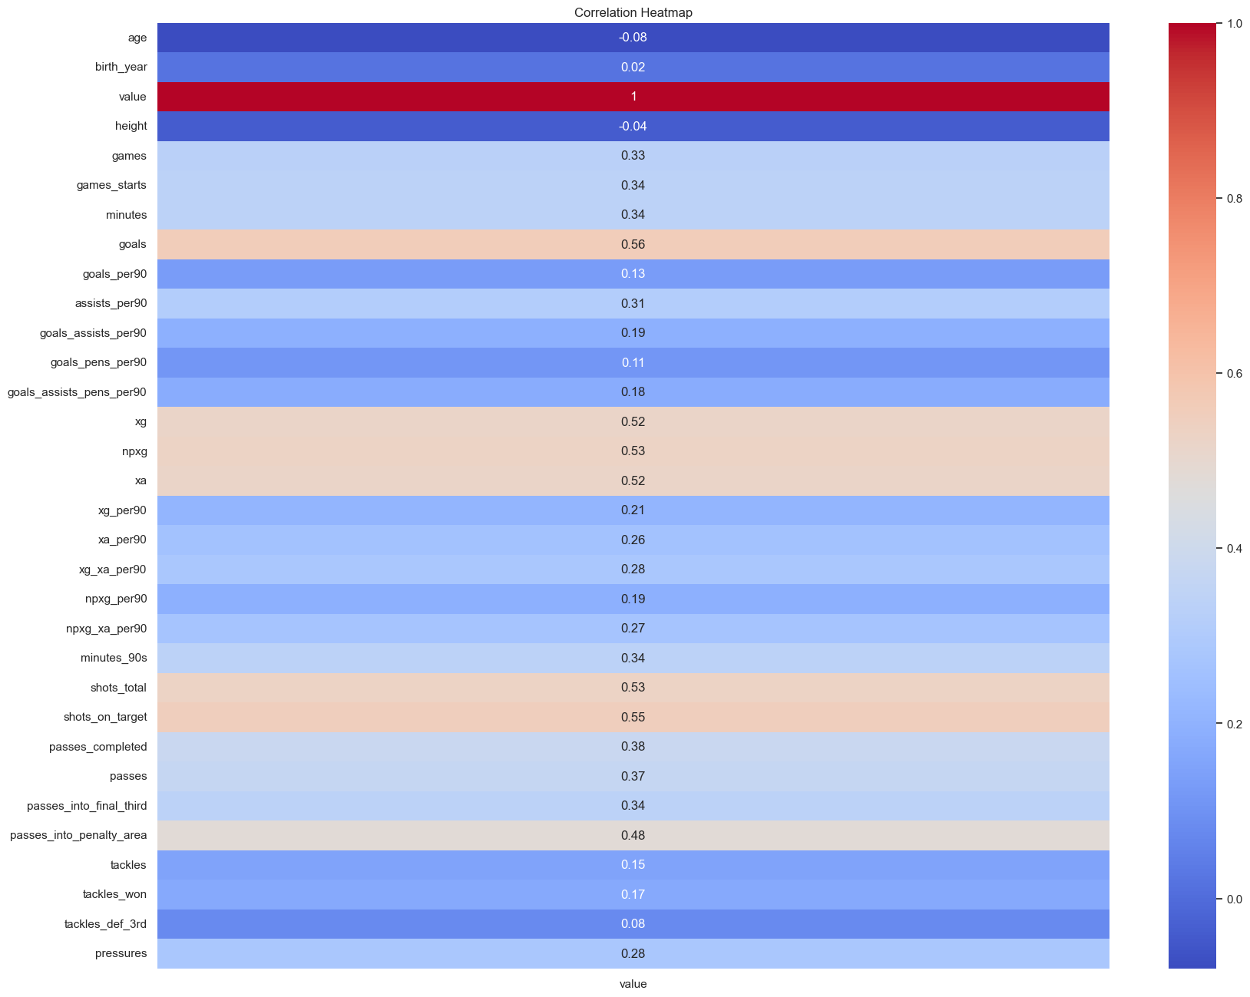
crucial
Variables

Slide 9
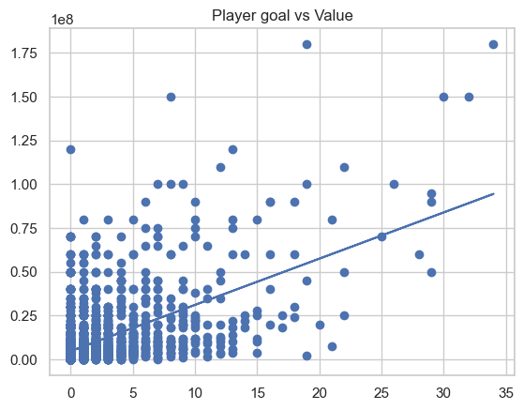
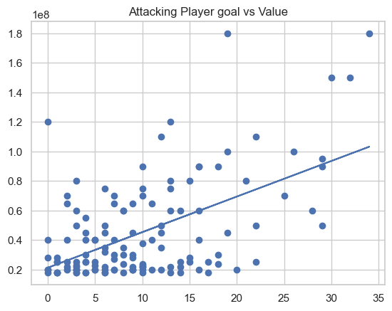
Goals vs Value

Slide 10
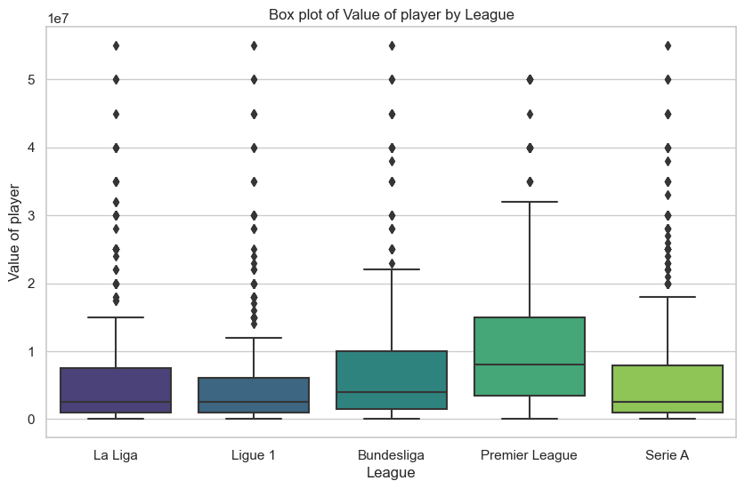
Value of the player by League
ANOVA test Results
Premier League player values differ from other leagues

Slide 11



Findings
Predicting the market value is a complex task that involves a multitude of factors:
Age
Nationality
Position
Popularity
The higher the players plays, the more expensive they will be. xG, passes completed, passes into penalty area
No defenders included in the top 20

Slide 12

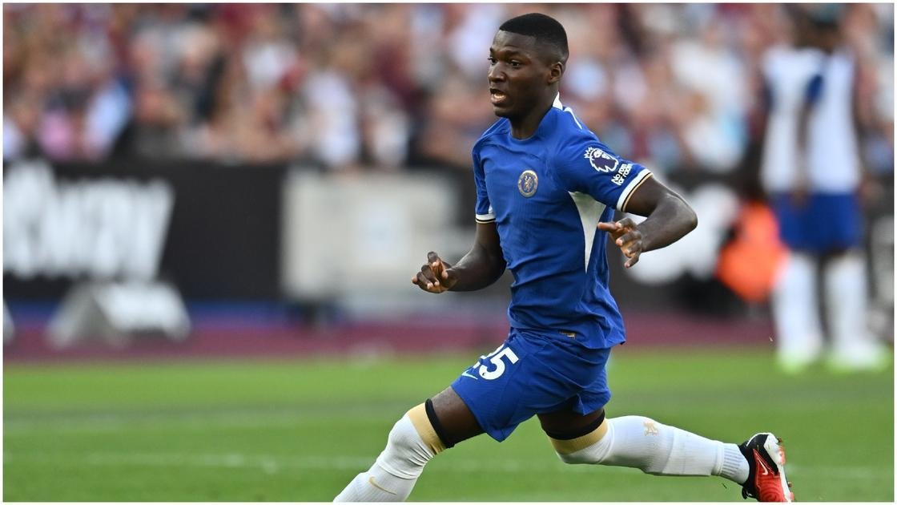
Implications
Premier league significant increase in spending in 2023.
Spent a record of £2.36 billion ($2.97 billion)
Since Todd Boehly, Chelsea has spent almost £1 billion
Moises Caicedo → £115M - £90M
Enzo Fernandez → £106M - £80M
Clubs are overspending and failing to manage finances accurately.
Everton faced 10 points deduction
Man city have been charged with 115 financial breaches

Slide 13
Recommendations
A balanced approach to player valuation and financial responsibility is crucial for the overall health of clubs.
It is recommended that clubs consider a range of performance metrics and off the field factors when assessing a players value.
It guides clubs to more informed decisions during player recruitment and avoiding financial implications.

Slide 14
References
He, Y. (n.d.). Predicting Market Value of Soccer Players Using Linear Modeling Techniques. Retrieved from University of California, Berkeley
Public Library of Science. (2023, August 16). Google Trends data can improve predictions of soccer players' market value.
Reuters. (2023, September 2). Premier League clubs spend record 2.36 billion pounds in the transfer window. Retrieved from Reuters:
Behravan, I., & Mohammad Razavi, S. (2020, October 24). A novel machine learning method for estimating football players’ value in the transfer market.

Slide 15

Thank you & Have a great winter break

